Slide 1
Classical Machine Learning Tools

Slide 2
Artificial General Intelligence (AGI)
AI that could successfully perform any intellectual task that a human can
(Turing test (1950), ...)
Artificial Intelligence (AI)
ML (DL) learning "human" abilities (speech and music recognition, conversation, visual recognition, video prediction, reasoning, self-driving cars, playing games, etc.)
Deep Learning (DL)
ML implemented as Neural Network
Machine Learning (ML)
DS where algorithm learns from data to make predictions
Data Science (DS)
computer skills + statistics
CSV files, SQL, PowerPoint

Slide 3
Machine Learning Systems = Prediction Machines
ML = "Cheap Predictions"
AI = "Cheap Predictions"
Ajay Agrawal
University of Toronto

Slide 4
OK, so what is Machine Learning?
- A computer program
- used to describe data in a compressed way
- to make predictions and take actions
- most common ML tasks - regression or classification
Neural Networks (Deep Learning)
Standard ML
Simple Analytics
Other standard ML models may have up to 1-2 thousand parameters.
Regression & Classification
Classification - Logistic Regression
Decision trees (Random Forest, XGBoost)
Clustering (K-Means, ...)
KNN (K-Nearest Neighbours)
SVM (Support Vector Machines),
PCA (Principal Component Analysis),
LDA (Linear Discriminant Analysis),
etc.
Typical example - classification – dog or cat. CNN model (Convolutional Neural Network)
may have millions of parameters.
Deep learning text (NLP) models may have up to 175 Bln parameters.
Some applications:
Recognizing images, music, speech
NLP = Natural Language Processing
Machine Translation
supervised, unsupervised, reinforcement learning
Generative Models (GANs)
Linear Regression y = f(x) = ax + b
Model uses only two parameters:
a = slope,
b = intercept

Slide 5
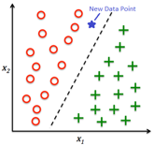
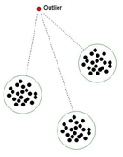
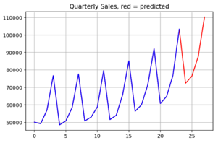
Five Most Common
"Classical" ML Algorithms
Regression
Classification
Anomaly Detection
Forecasting
Recommendation, Ranking
Data
Candidate
Generation
Ranking

Slide 6
Most Common "Classical" Algorithms
Regression & Classification .. Regression – draw line through points .. Classification – find to which class the data point belongs
Supervised vs unsupervised .. Supervised – data is "labeled" (cat or dog, bought or not, ...) .. Unsupervised – we need to find order in data (Clustering, Principal Component Analysis, etc.)
Predictive Analytics .. Regression .. Classification (this type of prospects buy with 70% probability) .. Recommendations (Collaborative Filtering – people who bought this also bought that) .. Time Series Forecasting with seasonality and trend
Anomaly Detection .. how far the event from the means or clusters
Recommendation & Ranking .. Amazon and Netflix recommendations .. Google search results .. Newsfeeds (Facebook, etc.)

Slide 7
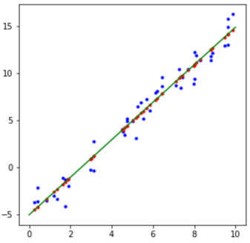
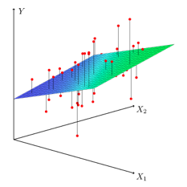
Model – Linear Regression
rng = np.random.RandomState(seed=None)
x = 10 * rng.rand(50) # 50 random numbers in [0,10]
y = 2 * x - 5 + rng.randn(50) # 50 numbers between [-5, 15]
from sklearn.linear_model import LinearRegression
model = LinearRegression(fit_intercept=True)
model.fit(x[:, np.newaxis], y) # here x - one or more columns, y - row
# show the model line:
xt = np.linspace(0, 10, 1000)
yt = model.predict(xt[:, np.newaxis]) # this will draw a line
yp = model.predict( x[:, np.newaxis])
fig, ax = plt.subplots()
_ = ax.scatter(x, y, marker='.', color='blue'); # training data
_ = ax.scatter(x, yp, marker='.', color='red'); # project onto the line
_ = ax.plot. (xt, yt, color='green'); # line
_ = plt.show();
Linear Regression y = f(x) = ax + b
Model uses only two numbers: a = slope, b = intercept
Multivariate Linear Regression

Slide 8
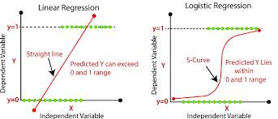
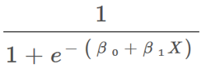
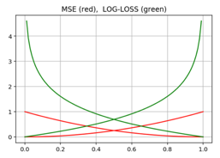
Logistic Regression
(binary classification model)
The "beta" coefficients are fitted
using Maximum Likelihood Estimation (MLE)
iteratively via gradient descent.
Common "Log-Loss error function" consists of two separate functions (for target values 0 and 1).
If “q” is model prediction, and “p” is probability of actual label, then similarity between q & p can be expressed as cross-entropy H(p,q):

Slide 9
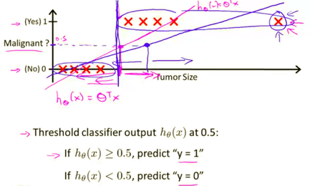
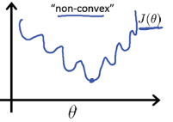
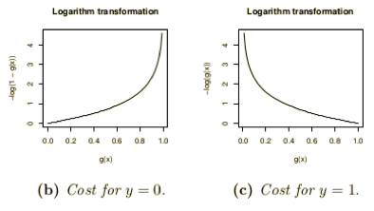
Why Mean Squared Error (MSE)
is not good for classification?
From Andrew Ng’s Machine Learning course (see on YouTube or Coursera)
First, MSE can force conversion to a wrong answer. On the picture to the right you can see how adding data points with big tumor sizes will shift the transition point toward larger sizes, thus changing diagnosis for some cases.
Second reason against MSE is that MSE loss function tend to be
non-convex - have multiple local minima, thus making it difficult to converge.
Finally, Cross-Entropy Error function gives bigger gradients and better conversion.

Slide 10
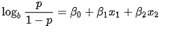
Binary Classification Problem
Example – two classes: red and grey.
Ensemble Tree Classifiers succeed
where Linear Classifiers fail
Ensemble tree classifiers
( Random Forest , XGBoost )
can solve complicated problems

Slide 11
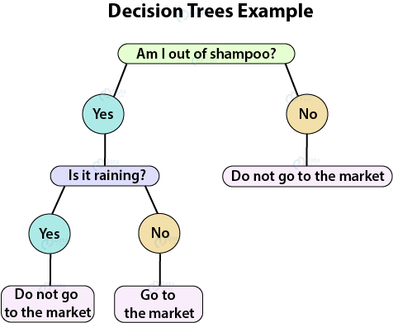
Decision Tree (DT)
DT goes from observations about an item (represented in the branches) to conclusions about the item's target value (represented in the leaves).
DT can do classification or regression.
DTs are intuitive and easily interpretable.
Algorithms for constructing DTs usually work top-down, by choosing and splitting on a variable at each step that most informative for the target label (produces the purest daughter nodes).
Splits can result in more than two branches.
Decision Tree Building Algorithms
ID3 (Iterative Dichotomiser 3) – uses smallest Entropy metrics
C4.5 – successor of ID3 (since 1993), uses Entropy metrics
CART (Classification And Regression Tree) – (since 1984), uses Gini metrics
CHAID (CHi-squared Automatic Interaction Detector). Performs multi-level splits when computing classification trees.
MARS: extends decision trees to handle numerical data better.
Conditional Inference Trees. Statistics-based approach that uses non-parametric tests as splitting criteria, corrected for multiple testing to avoid overfitting. This approach results in unbiased predictor selection and does not require pruning.
Trees:
Greedy splitting (top->down)
Greedy pruning (to prevent over-fitting)
Fast and easy to build
Surprisingly good
Explainable

Slide 12
Ensemble Learning
Idea - train several models to do predictions.
Then combine predictions of these models to get a better predictor.

Slide 13
Idea:
make a reliable system from unreliable blocks using single-shot democratic voting
Idea:
get to correct answer by making multiple corrective steps
Power of the majority
committee, senate, congress, council, board of directors, ...
1st approximation
Power of validation
science, open source community, ...
Computer 1
correction
Data
Computer 2
Majority voting
system
Weighted
voting
system
correction
Computer 3
...
correction
Bagging
Wrong bias is not removed,
it is simply averaged
Wrong bias is removed
using correction and validation
Boosting

Slide 14

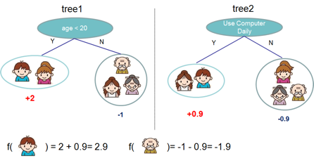
Ensemble Learning
Idea - train several models to do predictions.
Then combine predictions of these models to get a better predictor.
It is possible to combine any types of models into one predictor.
But commonly people combine variations of similar models, like decision trees models.
Two most famous approaches are:
- "Random Forest"
- "Gradient Boosted Trees"
Under the hood these models combine 100 ... 200+ similar trees.
The differences between algorithms:
how you select the data to train those trees
how you combine the predictions of these trees

Slide 15



FORTRAN
Random Forest
2002-2003
Richard A. Olshen
Biostatistics
UC Berkeley,
Stanford
1942-
Charles J. Stone
Math, Probability
UCLA,
UC Berkeley
1936-2019
Leo Breiman
UC Berkeley
Statistics
1928-2005
Jerome H. Friedman
Statistics
UC Berkeley,
Stanford
1939-
Classification and
Regression Trees
(1984) by BFOS (BFOS = Breiman, Friedman, Olshen, Stone)
Random Decision Forests
(1995) by Tin Kam Ho
Adele Cutler
UC Berkeley, then Utah State University.
Wrote original Random Forest in Fortran with Leo Breiman in 2002-2003
https://www.stat.berkeley.edu/~breiman/RandomForests/cc_software.htm
Tin Kam Ho
at Bell Labs in NJ.
then AI at IBM (since 2014)

Slide 16



Boosting Algorithms
Strength of Weak Learners
AdaBoost (1995) Yoav Freund & Robert Schapire
(2003 Gödel Prize).
Leo Breiman
UC Berkeley
Jerome H. Friedman
UC Berkeley,
Stanford
From Wikipedia, etc:
The idea of gradient boosting originated in the observation by Leo Breiman that boosting can be interpreted as an optimization algorithm on a suitable cost function (1997, Berkeley).
Explicit regression gradient boosting algorithms were subsequently developed by Jerome H. Friedman (1999, Berkeley).
... simultaneously with the more general functional gradient boosting perspective of Llew Mason, Jonathan Baxter, Peter Bartlett and Marcus Frean (1999).
Stochastic gradient boosting - by Jerome H.Friedman, 2002 – adding random sampling to gradient boosting algorithm improves speed and accuracy.
XGBoost (2014)
more flexible and optimized
Tianqi Chen (was a Ph.D. student)
Light GBM (2016, Microsoft) fast-performing, distributed
(GBM = Gradient Boosting Machine)
CatBoost (2017, Yandex)
big data, categorical data, multiple GPUs.

Slide 17
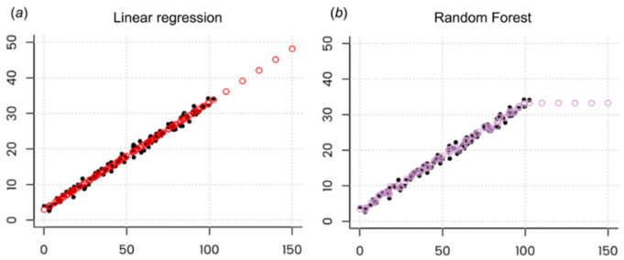
Ensemble Tree Regressors can NOT do extrapolation
For example, RandomForestRegressor or HistGradientBoostingRegressor.
It does interpolation for values inside the range of values.
But it can not go outside.
- https://neptune.ai/blog/random-forest-regression-when-does-it-fail-and-why
Ensemble Tree Regressors can be successfully used on de-trended time series.
Note – you need to forecast the trend separately.
Other approaches include SVM regression, Linear Regression, Deep Lerning (RNN), combining predictors using stacking, etc.
We can use modified versions of random forest, for example Regression Enhanced Random Forest (RERF, 2017):
- https://arxiv.org/pdf/1904.10416.pdf
RandomForest Regressor works by finding closest matches in given range.
We take random subset of data (columns, rows), and build a tree splitting by "x".
Each leave has "x" and "y".
We build hundred trees like this.
For inference, given value "x" we traverse all 100 trees (by "x") and find 100 values of "y".
Then we average them to get the desired prediction.
The result is always within the range of "y" values. It can not extrapolate.
If you look at prediction values they will look like this:

Slide 18
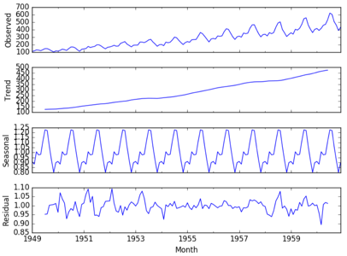

Time Series Forecasting
Naive Qualitative (forecast = last value, or an average of last period)
Trend, Linear Regression
Multivariate Linear Regression
Exponential Smoothing (weighted moving average)
Holt-Winters = Triple Exponential Smoothing (smooth, trend, seasonality)
Calendar Seasonality Features + "events" features, modeled using Random Forest or Boosted Trees (my favorite)
Fourier decomposition to model Seasonality
ARMA (Auto-Regressive Moving Average)
ARIMA (Auto-Regressive Integrated Moving Average)
SARIMA (S=Seasonality), SARIMAX (X - eXogenous regressors)
Auto-correlations, bivariate cross-correlation, multivariate time series analysis
Causal (cause-effect) - modeling specific causes/drivers that can influence the target value (drivers – number of resources, spending on advertising, promotion, legal change, website redesign, sport event, new law, election, etc.). Some drivers cause permanent shift, others – temporary response.
Monte-Carlo (Random Walk Simulation)
Neural Networks - LSTM (Long Short Term Memory), multivariate LSTM, GRU (Gated Recurrent Unit)
Facebook Prohpet -
Azure AutoML –
AWS DeepAR – supervised, uses RNN (Recurrent Neural Network), 1 or more time series
etc. etc.

Slide 19
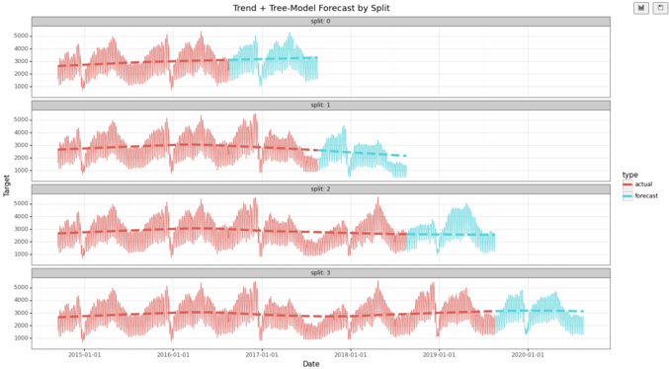
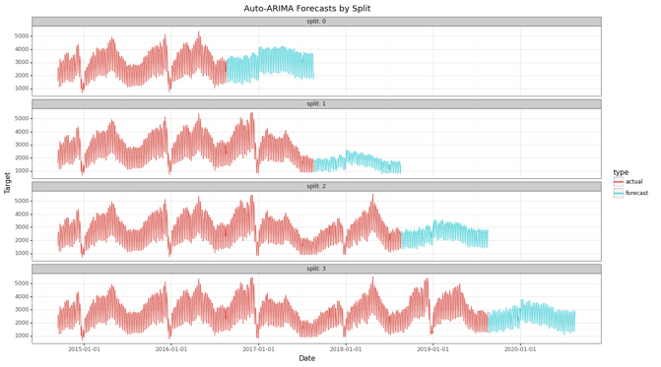
Forecasting Example
Two models – Trend + Ensemble-Tree model vs Auto-ARIMA (SARIMAX)
Method | Avg Error (across 4 splits) | Avg Train Time (across 4 splits)
Trend + Tree-Model | 14.6% | ~2sec
Auto-ARIMA (SARIMAX) | 21.6% | ~2min

Slide 20

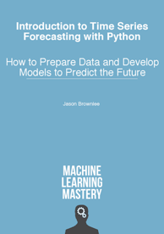
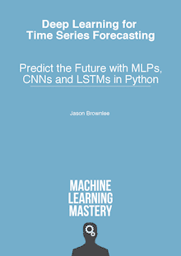
Jason Brownlee
Best two books on time series forecasting:
Jason Brownlee
Melbourne, Australia
Jason wrote 21 books on Machine Learning.
I highly recommend to buy all of them.
They come as PDF with separate python code files.
https://www.linkedin.com/in/jasonbrownlee/
https://machinelearningmastery.com/
https://SuperFastPython.com
Introduction to Time Series Forecasting With Python
Deep Learning for Time Series Forecasting

Slide 21



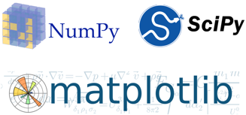

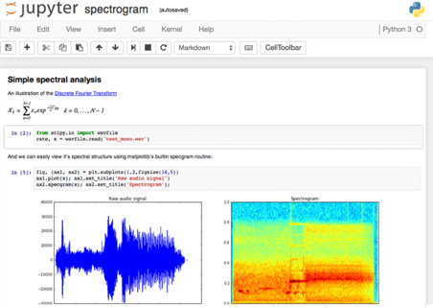

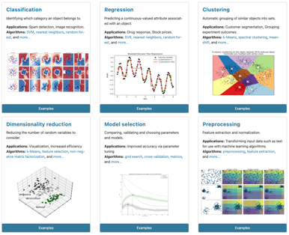
Python, Jupyter, Scikit-Learn, ...
Anaconda Python - https://www.anaconda.com
Jupyter notebooks - https://jupyter.org
python modules: - pandas - https://pandas.pydata.org - NumPy - https://numpy.org - matplotlib - https://matplotlib.org - scikit-learn - https://scikit-learn.org/stable - SciPy - https://scipy.org
For Deep Leaning: - Google TensorFlow+Keras - https://www.tensorflow.org - Facebook PyTorch - https://pytorch.org

Slide 22
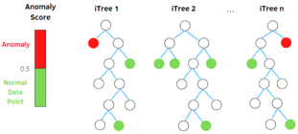
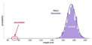
Anomaly Detection: Isolation Forest (IF) & RRCF
(RRCF = AWS Robust Random Cut Forest)
https://en.wikipedia.org/wiki/Isolation_forest -
https://stackoverflow.com/questions/63115867/isolation-forest-vs-robust-random-cut-forest-in-outlier-detection – Isolation Forest:
https://cs.nju.edu.cn/zhouzh/zhouzh.files/publication/icdm08b.pdf – paper
https://towardsdatascience.com/outlier-detection-with-isolation-forest-3d190448d45e – tutorial RCF:
http://proceedings.mlr.press/v48/guha16.pdf – paper
https://freecontent.manning.com/the-randomcutforest-algorithm/ - tutorial
Anomaly
Both algorithms are ensemble methods based on decision trees.
Both aim to isolate every single point.
Ouliers tend to require less steps to get isolated.
Isolation Forest (IF) is open source (sklearn), whereas AWS RRCF is closed source (although look at https://github.com/kLabUM/rrcf )
RRCF can work on streams (in streaming analytics service Kinesis Data Analytics) – it has partial_fit() method.
RRCF is more scalable, can be parallelized between multiple machines. It also supports Pipe mode (streaming data via unix pipes) which makes it able to learn on much bigger data than what fits on disk
RRCF performs better in high-dimensional space because it gives more weight to dimension with higher variance (according to SageMaker doc), while Isolation Forest samples at random
Anomaly score is calculated differently. IF's score is based on distance from the root node. RRCF is based on how much a new point changes the tree structure (i.e., shift in the tree size by including the new point). This makes RRCF less sensitive to the sample size

Slide 23
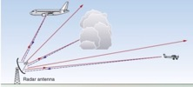
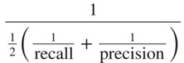
ROC Curve & Precision-Recall Curve
Receiver Operating Characteristic (ROC) curves for a binary classifier:
True Positive Rate (TPR) vs False Positive Rate (FPR)
at various threshold settings.
ROC curve was first developed by radar engineers during World War II
for quantifying the quality of detection of enemy airplanes.
TPR = REC = Recall or Sensitivity = TP/P = TP / (TP + FN)
( planes classified as planes / all planes' events)
FPR = False Positive Rate = fall-out = FP / N = FP / (FP + TN)
( noise classified as planes / all noise events )
PRE = Precision = TP/(TP+FP)
( planes classified as planes / all events classified as planes)
TNR = SPC = Specificity = TN/N = TN/(FP+TN)
(True Negative Rate)
--------------------------------------------------------------------------------
AUC = Area Under the Curve
Simply the area under the ROC curve (1 = very good, 0.5 = bad)
--------------------------------------------------------------------------------
F1 Score - a single number evaluation metric, harmonic average
of the precision and recall :
Radar detects planes.
It need to separate
"plane" signals from noise.
Planes
Noise
High Precision, Low Recall
Selecting Threshold
Low Precision, High Recall
Recall
Low Threshold
ROC
Curve
Precision-Recall
Curve
High Threshold
FPR

Slide 24


Noise
Planes
Noise
Planes
Precision – 100%
Recall – 15%
Good Precision = Sniper
Noise
Planes
Precision – 50%
Recall – 100%
Good Recall = Cover All
Good
Noise
Planes
Ideal:
Precision – 100%
Recall – 100%
+
Noise
Planes
Good:
Precision – 90%
Recall – 90%

Slide 25
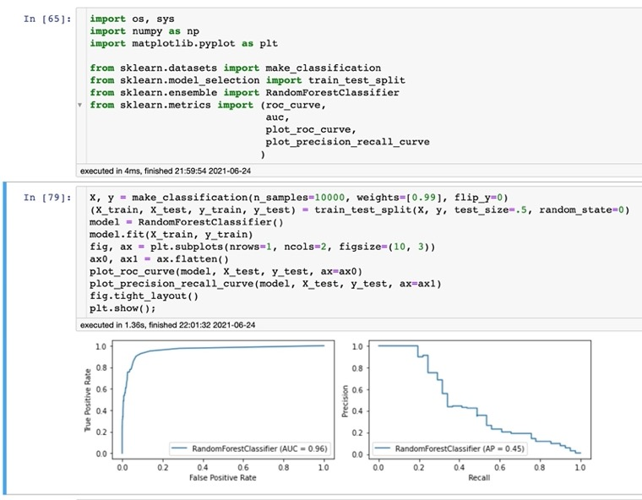
ROC AUC is terrible for imbalanced data.
Precision-Recall is much better.
Imagine imbalanced data set:
for 10 airplanes we get 10,000 noise spikes.
Suppose we have a classifier with reasonably good ROC curve, which at the "sweet spot" identifies 90% of planes and only 1% of noise as planes. The AUC will be very close to 1.
But it is actually a terrible classifier.
Because it will cry "plane!" for noise spikes 10 times more than for real planes!
The Precision-Recall curve is a much better indicator. Please see example on the right.
ROC
Precision - Recall

Slide 26
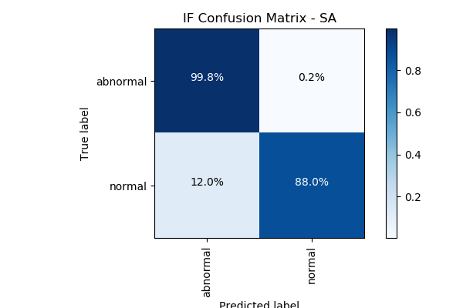
Confusion Matrix
For a simple binary classifier we are predicting one of two possibilities (Yes/No, Positive/Negative, Plane/No-Plane, Normal/Abnormal, etc.).
So we construct a 2x2 matrix to visualize True & False Positives and Negatives.
from sklearn import metrics
expected = target
predicted = model.predict(data)
metrics.precision_score(expected, predicted)
metrics.recall_score(expected, predicted)
metrics.roc_curve(expected, predicted)
metrics.roc_auc_score(expected, predicted)
metrics.confusion_matrix(expected, predicted)
[[194156 4864]
[ 23 321]]
Accuracy = sum(Diagonal) / sum(ALL) = sum(Correct) / sum(ALL)
Precision = TP / (TP+FP)
Recall = TP / (TP+FN) = TP / All_Actual_Positives

Slide 27
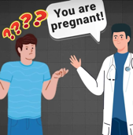

Type I and Type II Errors
 | Accept H₀ | Reject H₀
H₀ is True | Correct | type I error (rejected True)
H₀ is False | type II error (accepted False) | Correct
Two types of Errors:
Type I error - false rejection of the null hypothesis "false-positive" conclusion: .. innocent person convicted .. positive COVID test for a healthy person
Type II error - false acceptance of the null hypothesis "false negative" conclusion: .. guilty person not convicted .. sick person is released as healthy
The type of error depends on the null hypothesis
Example: COVID test.
Null Hypothesis 1: person has COVID.
Error Type 1 is when the test says "Healthy" on a sick person
Error Type 2 is when the test says "Sick" on a healthy person
Null Hypothesis 2: person is Healthy.
Error Type 1 is when the test says "Sick" on a healthy person
Error Type 2 is when the test says "Healthy" on a sick person
Choosing null hypothesis:
guilty / innocent: the person is presumed innocent until proven guilty.
Null Hypothesis = "Innocent"
sick / healthy: the person is presumed healthy.
Null Hypothesis = "Healthy"
airplaine / noise: the signals are mostly noise.
Null Hypothesis = "Noise"

Slide 28
Medical Test Paradox – Predictive Power of Positive or Negative Test Result
from https://www.youtube.com/watch?v=lG4VkPoG3ko
Healthy
Sick
We have 1,000 people.
1% of them have a disease:
N_sick = 10
N_healthy = 990
We use a test with sensitivity SE = 90% and specificity SP = 91%.
This means that test shows results as following:
TP = True Positive = N_sick * SE/100 = 9 out of 10
TN = True Negative = N_healthy * SP/100 = 901 out of 990
FN = False Negative = 1 out of 10
FP = False Positive = 89 out of 990
What is the predictive power of this test?
Positive result : TP/(TP+FP) = 9/(9+89) = 0.092 (1 in 11 chance)
Negative result : TN/(TN+FN) = 901/(901+1) = 0.999 (very good)
Test Results:
Red = Positive
White = Negative
Specificity
Sensitivity
 | Positive | Negative
Disease | 9 | 1
Healthy | 89 | 901
Sensitivity = Recall = True Positive Rate (TPR) : TPR = (TP / P) = TP / (TP + FN)
Specificity (SPC) = True Negative Rate (TNR) : SPC = (TN / N) = TN / (FP + TN)

Slide 29
How to find "REGULARITY"
High Bias model
(underfitting,
model too simple)
Bias/Variance Trade-off,
Good Generalization
High Variance model
(model too complex,
overfitting - fits noise)
Overfitting and Regularization
Goal of training the model is to fit/learn a "regularity" in the data, and to avoid fitting noise (avoid overfitting).
How do we know that we are overfitting?
Let's split data into two sets:
- training
- testing
If we overfit on the training data (learn regularity and some noise specific to the training data), then accuracy measured on the test data may be bad
(model doesn't generalize well).
Solution – try to find a more "regular" solution (less noise, less overfitting).

Slide 30
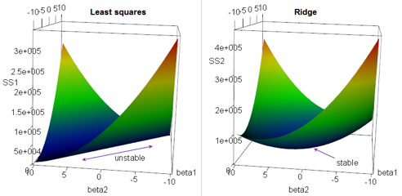
Regularization: Ridge Regression
Multivariate (multiple) Linear Regression Regularization.
Suppose we have a OLS (Ordinary Linear Squared) regression where two parameters x1 & x2 are not orthogonal, but are equal, proportional to each other, or highly correlated. Then there may be an infinite number of coefficients which will fit the model.
For example, (a*x1 - x2), (100*a*x1 - 100*x2), etc.
If we are trying to minimize the cost function in the multidimensional
space of coefficients, we will get an infinite diagonal groove (ridge)
for a*x1 = x2. Any place at the bottom of this ridge is equally good for us.
So we will get a big variability in possible values of coefficients for x1 & x2.
In other words, the solution will be unstable.
We can reduce this variability by adding additional regularization factor to the loss function as a sum of squares of coeffitients. When we minimizing this expression, bigger "lambda" value will cause smaller "beta" values, thus keeping the coefficients "beta" from becoming too large.
This is called "Ridge Regression".
It changes the infinitely long ridge into a local minimum.
Why Ridge Regression is called Ridge ...

Slide 31
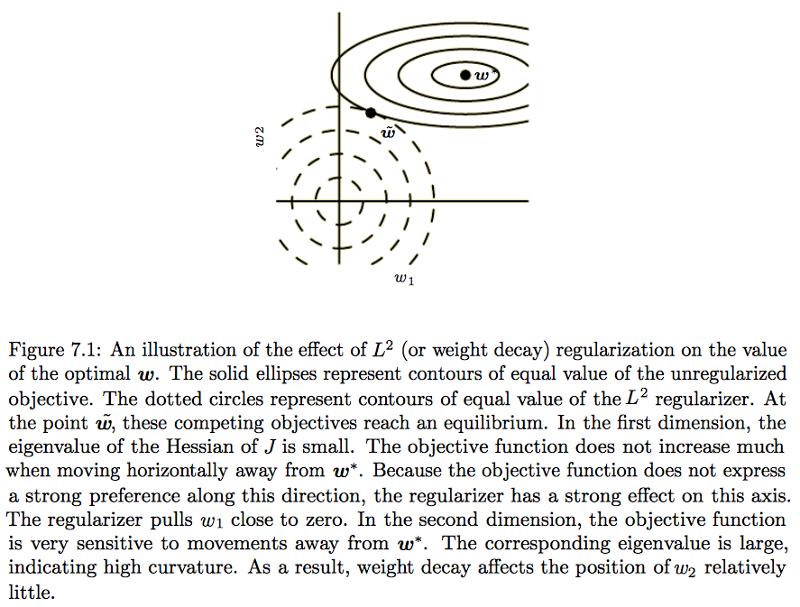
Minimum “cost”
without regularization
One way to do avoid overfitting can be to avoid big "weights" in the model.
Compromize
min(cost + penalty)
Cons: bias (shift),
Pros: low variance
Minimum of the “penalty” regularization term

Slide 32
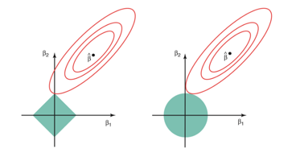
Regularization - LASSO, Elastic Net
In Ridge Regression we add a "regularization" term as sum of squares (L2 norm).
In LASSO Regression we add a "regularization" term as sum of abs values (L1 norm).
LASSO = Least Absolute Shrinkage and Selection Operator.
LASSO favors solutions on the tips of the bounding surface for coefficients,
where some of coefficients are zero. Thus it favors "sparse" solutions.
Elastic Net - A combination of Ridge Regression and LASSO.
Why LASSO favors sparse solutions
Fig 6.7 from "An Introduction to Statistical Learning"
by Gareth James, Daniela Witten, Trevor Hastie, Robert Tibshirani (Springer 2013-2017)
Contours of the error and constraint functions for the lasso (left) and ridge regression (right). The solid blue areas are the constraint regions, | β₁ | + | β₂ | ≤ s and β₁² + β₂² ≤ s, while the red ellipses are the contours of the RSS (Residual Sum of Squares).

Slide 33
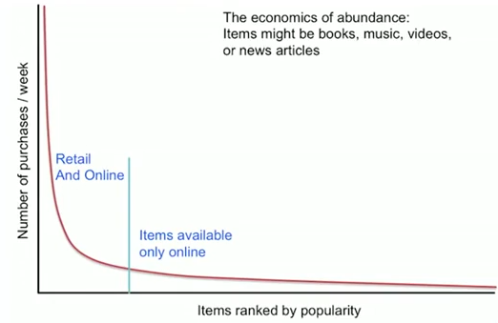
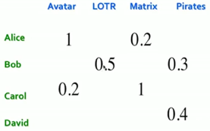
Recommender Systems
Long Tail
Content based (CB) – based on user history
Collaborative filtering (CF) – based on other users
Latent factor based (users and products presented as latent vectors)
Total sales in long-tail may be big,
but sales of each individual item are small
and each item is almost invisible.
Recommendations help to sell items in "long tail".
- Lists of favorites, “essential” items
- List of “Top 10”, Most popular, New items
- Tailored to individual users
Utility Matrix:
Ratings:
- Explicit reviews and ratings
- Implicit from user buying behavior
Problem: Utility Matrix is very sparse, most people haven’t rated most items.
Problem: New items have no ratings, new users have no ratings

Slide 34
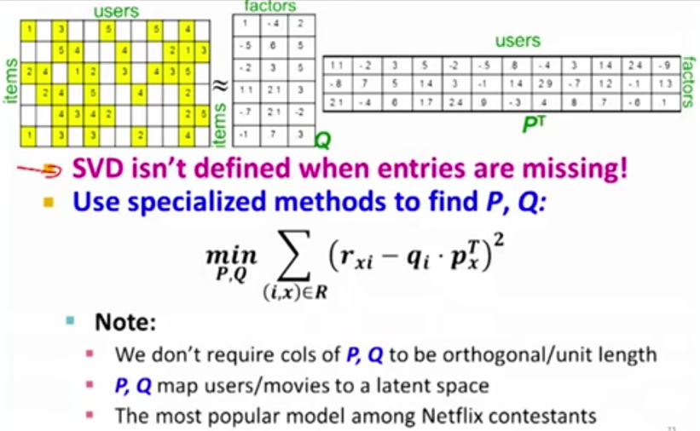
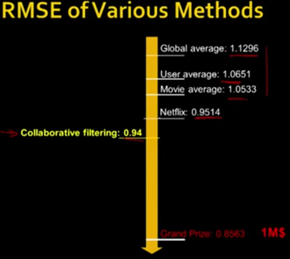
Latent Factor Recommender Systems
Dimensionality Reduction
Each user is represented as a K-dimensional vector of latent variables.
Each movie is also represented as a K-dimensional vector (in picture below K=3)
We decompose original utility matrix into a product of 2 matrixes of latent vectors.
This is “matrix factorization”.
To find latent vectors, we solve minimization problem.
If some rows/columns of a matrix can be presented as linear combinations of others, this decreases the “rank” of the matrix. We can then reduce the matrix to a smaller matrix (for example, convert from 3D to 2D plane).
Netflix prize (2009)

Slide 35
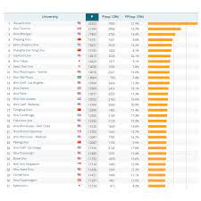
Ranking
https://en.wikipedia.org/wiki/Ranking
Ranking is a week ordering of items by assigning a rank (a positive integer number) to each item.
Rank is inversely related to the value. We say that the ranking is "higher" if the value of the assigned rank integer number is "lower". So, for example, rank 2 is higher than rank 3. The highest possible rank is 1.
Difference between Rating and Ranking: .. Rating usually means a category or a range of values. "a classification or ranking of someone or something based on a comparative assessment of their quality, standard, or performance." .. Ranking = ordering number between values
Ranking used in statistics (wikipedia)
Predictive vs. Earned (historic) Ranking
Real-time ranking
Top-N
Rank using multiple features
Numeric, extract sentiment, etc.
Loss functions: Ranking Loss, Contrastive Loss, Margin Loss, Triplet Loss, Hinge Loss, etc.
Ranking models using Neural Networks
Learning to rank (multiple methods): https://en.wikipedia.org/wiki/Learning_to_rank
xgb.XGBRanker: https://medium.com/predictly-on-tech/learning-to-rank-using-xgboost-83de0166229d
sklearn: https://towardsdatascience.com/learning-to-rank-with-python-scikit-learn-327a5cfd81f
Microsoft: https://lucidworks.com/post/abcs-learning-to-rank/ - RankNet, LambdaRank, LambdaMART
scikit-network: https://scikit-network.readthedocs.io/en/latest/reference/ranking.html
sklearn-ranking: https://pypi.org/project/sklearn-ranking/
LTR: https://everdark.github.io/k9/notebooks/ml/learning_to_rank/learning_to_rank.html

Slide 36
LightGBM As Ranker
https://medium.com/@raghavbhutani41/gradient-boosting-ranking-algorithm-lightgbm-667050dddaaf
https://lightgbm.readthedocs.io/en/latest/pythonapi/lightgbm.LGBMRanker.html
from sklearn.model_selection import train_test_split
X_train, X_test, y_train, y_test = train_test_split(X, y, test_size=0.2, random_state=1)
X_train, X_val, y_train, y_val = train_test_split(X_train, y_train, test_size=0.2, random_state=1)
query_train = [X_train.shape[0]]
query_val = [X_val.shape[0]]
query_test = [X_test.shape[0]]
import lightgbm as lgb
gbm = lgb.LGBMRanker()
gbm.fit( X_train, y_train,
group=query_train,
eval_set=[(X_val, y_val)],
eval_group=[query_val],
eval_at=[5, 10],
early_stopping_rounds=50 )

Slide 37
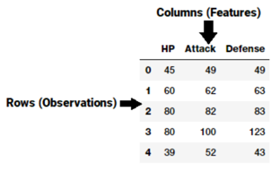
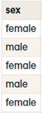
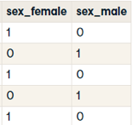
Feature Engineering
Cleaning Data and Feature Engineering typically take 80% of time of a Data Science Project!
A feature is typically
a column in a data set
"Feature engineering is the process of transforming raw data into features that better represent the underlying problem to the predictive models, resulting in improved model accuracy on unseen data." - Dr. Jason Brownlee
Typical Operations:
Removing obviously non-relevant data (empty or not-changing columns/rows, row_id, etc. )
Synthetic Features (Example: Income / Price)
Select relevant columns (Kolmogorov-Smirnov test, etc.)
Sparse features – consider converting/combining (Example: grouping penny-stocks together)
Impute missing data (with mean, median, most frequent, KNN, extrapolation or interpolation, MICE (Multivariate Imputation by Chained Equation), etc.
Outliers (use box-plots and scatterplots to find), filter-out or change
Collinearity – reduce (combine features, use PCA (Principal Component Analysis)
Factor Analysis (finding underlying common factor for several features) – reduce number of features
Aggregating, Binning / Bucketing - df[col] = pd.qcut(df[col], 10)
Grouping of some features together (numeric - sum() or mean(), categorical – by frequency)
Transformations & Interactions (see H2O.ai Driverless AI as a good example)
One-hot Encoding ( use pd.get_dummies() function in pandas)
Split features (for example, split text)
Scaling (Normalization or Standardization)
Dates – convert to features (Day of week, Month, Year, Day of year, Quarter, diff between dates)
Feature Importance – training with different subsets of features (ex. Random Forest) allows to figure out feature importance – and helps to remove non-important features
Text - extract synthetic features (for example, sentiment (Positive, Neutral, Negative)
One-Hot Encoding

Slide 38
Feature Engineering Tools – sklearn
6.4. Imputation of missing values
6.4.1. Univariate vs. Multivariate Imputation
6.4.2. Univariate feature imputation
6.4.3. Multivariate feature imputation
6.4.4. References
6.4.5. Nearest neighbors imputation
6.4.6. Marking imputed values
6.5. Unsupervised dimensionality reduction
6.5.1. PCA: principal component analysis
6.5.2. Random projections
6.5.3. Feature agglomeration
6.6. Random Projection
6.6.1. The Johnson-Lindenstrauss lemma
6.6.2. Gaussian random projection
6.6.3. Sparse random projection
6.7. Kernel Approximation
6.7.1. Nystroem Method for Kernel Approximation
6.7.2. Radial Basis Function Kernel
6.7.3. Additive Chi Squared Kernel
6.7.4. Skewed Chi Squared Kernel
6.7.5. Polynomial Kernel Approximation via Tensor Sketch
6.7.6. Mathematical Details
6.8. Pairwise metrics, Affinities and Kernels
6.8.1. Cosine similarity
6.8.2. Linear kernel
6.8.3. Polynomial kernel
6.8.4. Sigmoid kernel
6.8.5. RBF kernel
6.8.6. Laplacian kernel
6.8.7. Chi-squared kernel
6.9. Transforming the prediction target (y)
6.9.1. Label binarization
6.9.2. Label encoding
Pandas, NumPy, Matplotlib, Seaborn
Scikit-learn Dataset transformations: https://scikit-learn.org/stable/data_transforms.html
6.1. Pipelines and composite estimators
6.1.1. Pipeline: chaining estimators
6.1.2. Transforming target in regression
6.1.3. FeatureUnion: composite feature spaces
6.1.4. ColumnTransformer for heterogeneous data
6.1.5. Visualizing Composite Estimators
6.2. Feature extraction
6.2.1. Loading features from dicts
6.2.2. Feature hashing
6.2.3. Text feature extraction
6.2.4. Image feature extraction
6.3. Preprocessing data
6.3.1. Standardization, or mean removal and variance scaling
6.3.2. Non-linear transformation
6.3.3. Normalization
6.3.4. Encoding categorical features
6.3.5. Discretization
6.3.6. Imputation of missing values
6.3.7. Generating polynomial features
6.3.8. Custom transformers

Slide 39
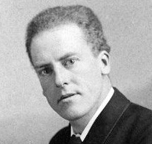
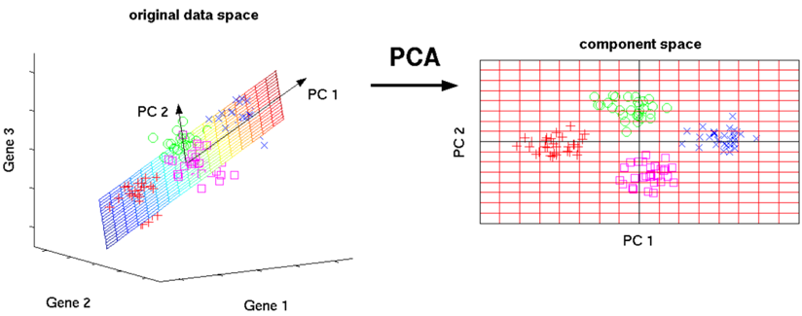
PCA = Principal Component Analysis
PCA was developed by Karl Pearson (in 1901)
Creates linear combinations of the original features. The new features are orthogonal, (uncorrelated).
Furthermore, they are ranked in order of their "explained variance." The first principal component (PC1) explains the most variance in your dataset, PC2 explains the second-most variance, and so on.
These new features are then used in a machine learning model in place of the original features that were used to generate the principal components.
Karl Pearson
from sklearn import decomposition
# ...
pca = decomposition.PCA(n_components=3)
pca.fit(X)
X = pca.transform(X)

Slide 40

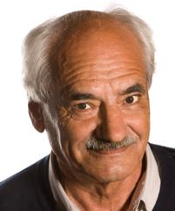
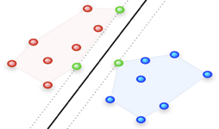


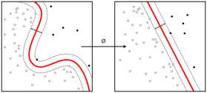
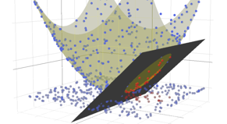
Support Vector Machine (SVM)
The original SVM algorithm was invented by Vladimir N. Vapnik and Alexey Ya. Chervonenkis in 1963. In 1992, Bernhard E. Boser, Isabelle M. Guyon and Vladimir N. Vapnik suggested a way to create nonlinear classifiers by applying the kernel trick to maximum-margin hyperplanes.
A vanilla SVM is a type of linear separator. We draw a straight line through our data down the middle to separate it into two classes.
If we can't draw a line through data, we can transform the data into a feature representation where the separation becomes possible.
“kernel trick” – use “kernel functions”, which enable them to operate in a high-dimensional, implicit feature space without ever computing the coordinates of the data in that space, but rather by simply computing the inner products between the images of all pairs of data in the feature space. This operation is often computationally cheaper than the explicit computation of the coordinates. This approach is called the "kernel trick".
Vladimir N. Vapnik
Alexey Chervonenkis
Isabelle M. Guyon
Bernhard E. Boser

Slide 41

SVM Continued ...
A nonlinear classification problem can be converted to a linear classification problem by mapping the input vectors from the input space to a higher dimensional feature space.
A kernel is a similarity function. It is a function that you, as the domain expert, provide to a machine learning algorithm. It takes two inputs and spits out how similar they are. You use kernels instead of dot-products of your vectors.
Many machine learning algorithms can be expressed entirely in terms of dot products.
Mercer's theorem: Under some conditions, every kernel function can be expressed as a dot product in a (possibly infinite dimensional) feature space.
In many cases, computing the kernel is easy, but computing the feature vector corresponding to the kernel is really really hard. The feature vector for even simple kernels can blow up in size.
For kernels like the RBF (Radial Basis Function) kernel ( k(x,y) = exp( -(x-y)²),
the corresponding feature vector is infinite dimensional. Yet, computing the kernel is almost trivial.
Many machine learning algorithms can be written to only use dot products,
and then we can replace the dot products with kernels.
By doing so, we don't have to use the feature vector at all. This means that we can work with highly complex, efficient-to-compute, and yet high performing kernels without ever having to write down the huge and potentially infinite dimensional feature vector.
Polynomial kernels can be thought of projecting a vector into a higher dimensional space. Gaussian kernel can be thought as a projection into infinite-dimensional space because its Taylor expansion has infinite number of elements.

Slide 42
K-Nearest Neighbors (KNN)
Identify new data based on proximity to old data.
"Tell me who your closest five friends are,
and I will tell you who you are"

Slide 43
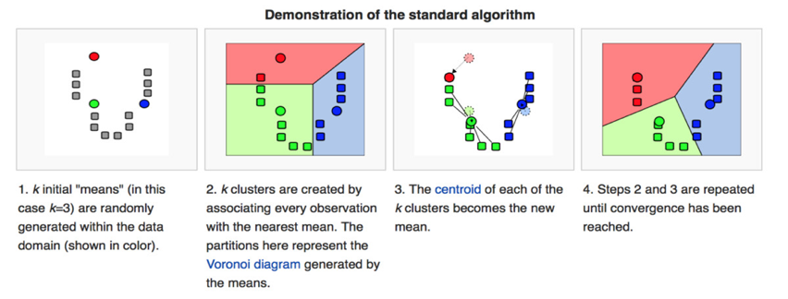
K-means clustering Partition “n” observations into “k” clusters
in which each observation belongs to the cluster with the nearest mean
K-means algorithm finds clusters iterativly repeating two steps:
- Assignment step: Assign each observation to the cluster whose mean has the least squared Euclidean distance (this is intuitively the "nearest" mean)
- Update step: Calculate the new means as centroids of the observations in the new clusters.

Slide 44
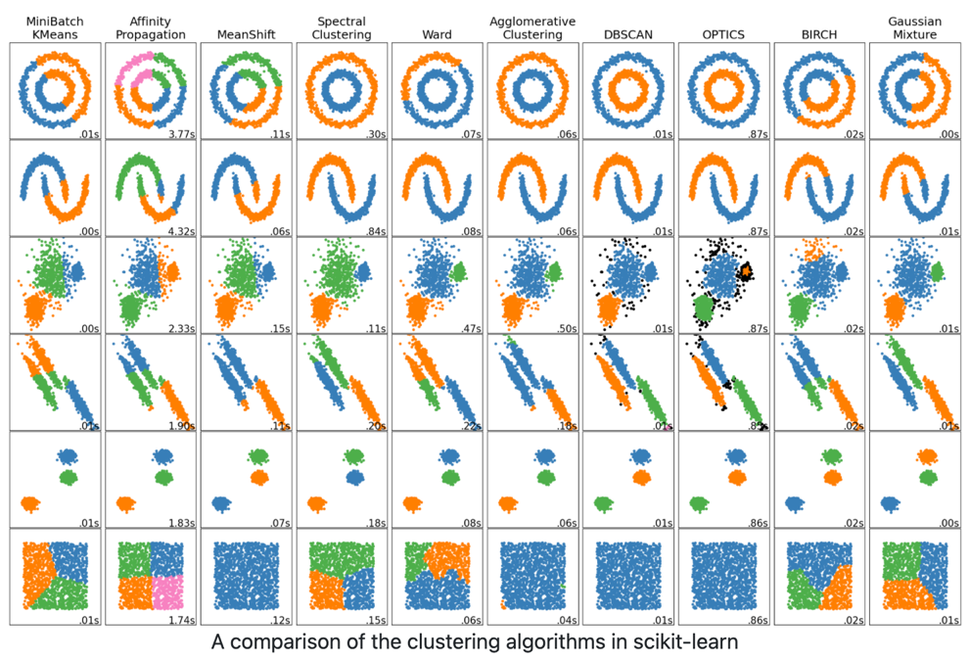
Clustering Algorithms

